Slide 1
TCP/IP
Hva er dette tullet?

Slide 2
TCP/IP
Hva er dette tullet?
ENDA EN MODELL?!

Slide 3
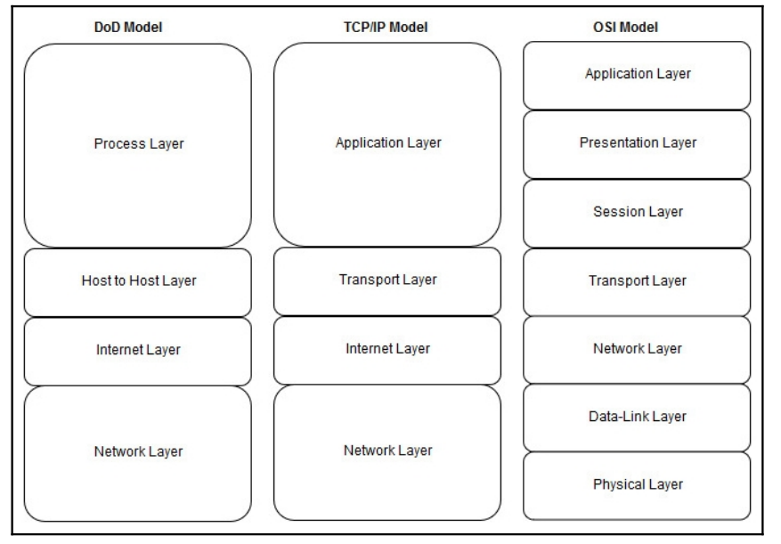
Alternativ til OSI modellen

Slide 4
Application
Same as Application layer in OSI
Acts as a glue between applications and network protocols
Telnet
FTP
TFTP
SMTP
DNS

Slide 5
Transport
Same as OSI
TCP
UDP
Data integrity
Sequence
Flow Control
Multiplexing

Slide 6
Internet
Same as «network layer» in OSI
IP
ICMP
IGMP

Slide 7
Network
OSI: Datalink + Physical
Communiaction within the same subnet
MAC
IEEE 802.3 Ethernet
IEEE802.11 WiFi
PPP
ARP
Frame Relay

